Slide 1
Mathematical Economics
Lecture 2

Slide 2

Plan
Metric Spaces
Convergence in Metric Spaces
Sequences in $ℝ$ and $ℝ^{m}$
Bolzano-Weierstrass theorem
Infinite sums

Slide 3
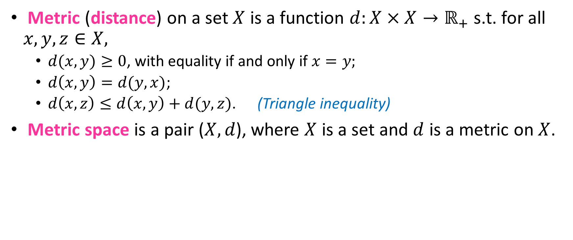
Metric Spaces
Metric (distance) on a set $X$ is a function $d:X×X→ℝ_{+}$ s.t. for all $x,y,z∈X,$
$d(x,y)≥0$, with equality if and only if $x=y;$
$d\left(x,y\right)=d(y,x)$;
$d\left(x,z\right)≤d\left(x,y\right)+d(y,z)$. (Triangle inequality)
Metric space is a pair ($X,d$), where $X$ is a set and $d$ is a metric on $X$.
y
x
z

Slide 4
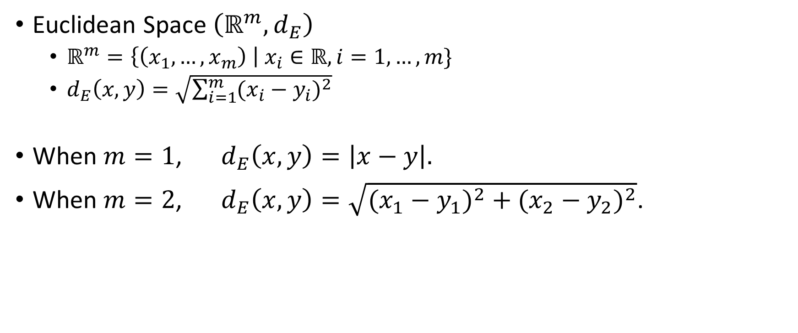
Metric Spaces: Examples
Euclidean Space $\left(ℝ^{m},d_{E}\right)$
$ℝ^{m}=\left\{\left(x_{1},…,x_{m}\right) \right| x_{i}∈ℝ, i=1,…,m\}$
$d_{E}\left(x,y\right)=\sqrt{\sum_{i=1}^{m}{(x_{i}−y_{i})^{2}}}$
When $m=1$, $d_{E}\left(x,y\right)=\left|x−y\right|.$
When $m=2$, $d_{E}\left(x,y\right)=\sqrt{(x_{1}−y_{1})^{2}+(x_{2}−y_{2})^{2}}$.

Slide 5







Metric Spaces: Open and Closed Balls
In a metric space ($X,d$),
Open ball with center x and radius ε is
$$B_{ε}\left(x\right)=\left\{y∈X \right| d\left(x,y\right)<ε\}.$$
Closed ball with center x and radius ε is
$$B_{ε}[x]=\left\{y∈X \right| d\left(x,y\right)≤ε\}.$$
$$ε$$
$$ε$$
$$x$$
$$x$$
$$B_{ε}\left(x\right)$$
$$B_{ε}[x]$$

Slide 6



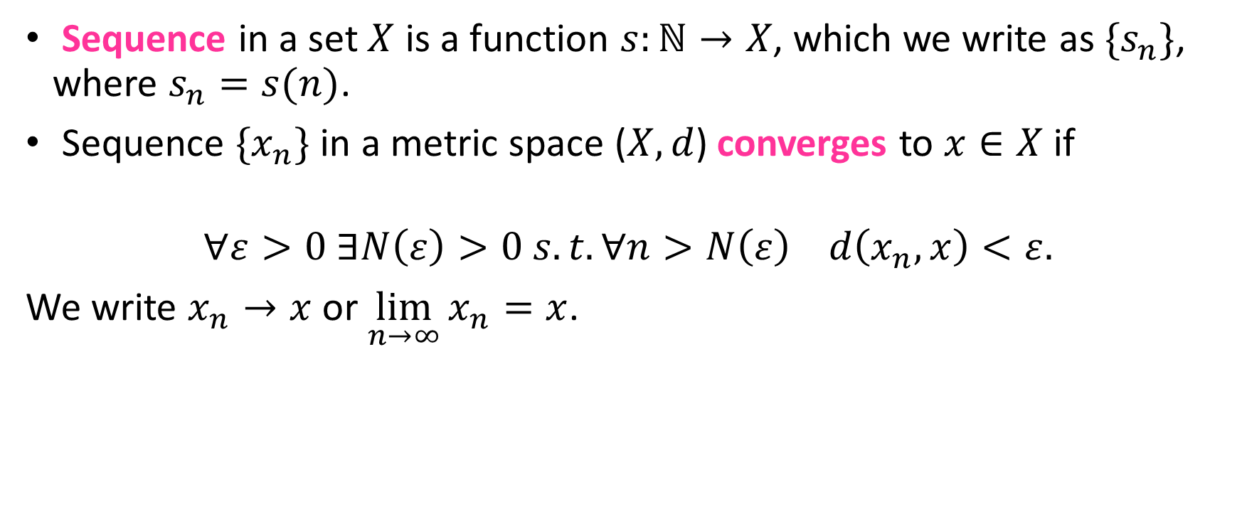






Convergence in Metric Spaces
Sequence in a set $X$ is a function $s:ℕ→X$, which we write as ${\{s}_{n}\}$, where $s_{n}=s(n)$.
Sequence ${\{x}_{n}\}$ in a metric space ($X,d$) converges to $x∈X$ if
$$∀ε>0 ∃N\left(ε\right)>0 s.t.∀n>N\left(ε\right) d\left(x_{n},x\right)<ε.$$
We write $x_{n}→x$ or $\lim_{n→∞}{x_{n}=x}$.
$$x_{2}$$
$$x_{N\left(ε\right)+5}$$
$$x_{N(ε)}$$
$$x_{2N\left(ε\right)}$$
$$x_{1}$$
$$x$$
$$ε$$
$$x_{N\left(ε\right)+1}$$
$$B_{ε}\left(x\right)$$

Slide 7
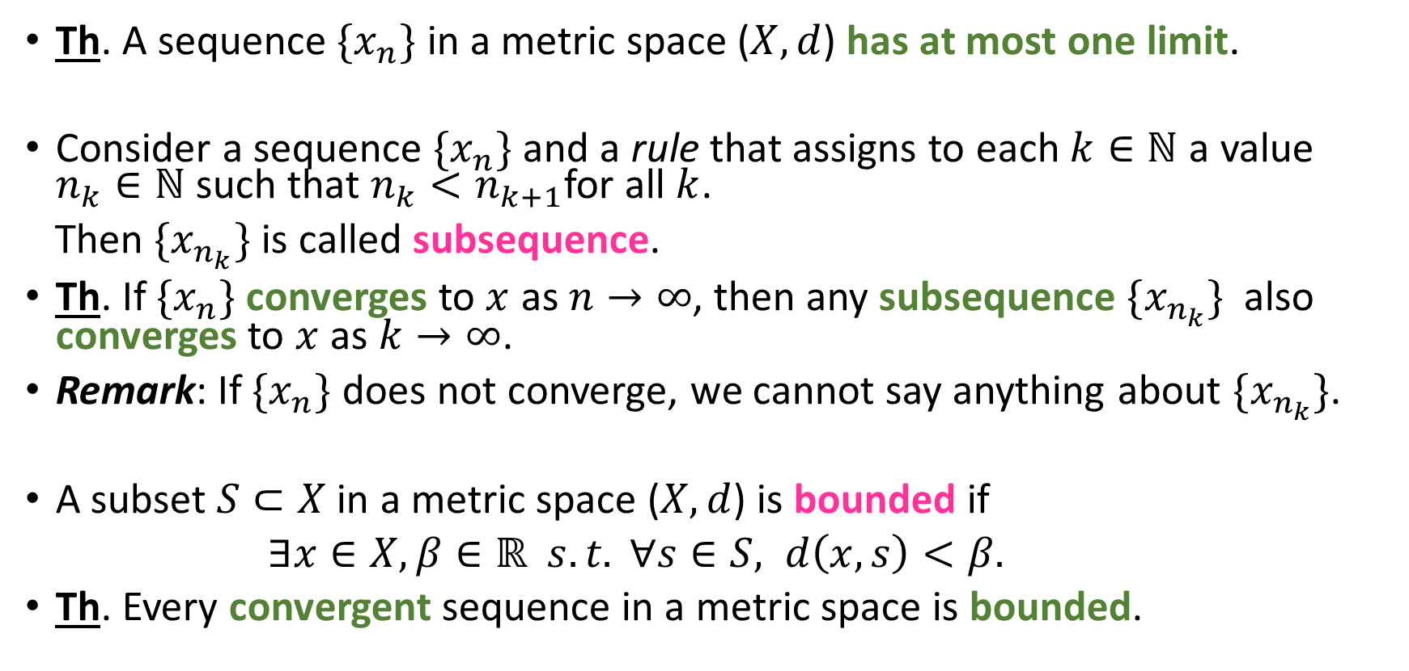
Convergence Theorems
Th. A sequence ${\{x}_{n}\}$ in a metric space ($X,d$) has at most one limit.
Consider a sequence ${\{x}_{n}\}$ and a rule that assigns to each $k∈ℕ$ a value $n_{k}∈ℕ$ such that $n_{k}<n_{k+1}$for all $k$.
Then ${\{x}_{n_{k}}\}$ is called subsequence.
Th. If ${\{x}_{n}\}$ converges to $x$ as $n→∞$, then any subsequence ${\{x}_{n_{k}}\}$ also converges to $x$ as $k→∞$.
Remark: If ${\{x}_{n}\}$ does not converge, we cannot say anything about ${\{x}_{n_{k}}\}$.
A subset $S⊂X$ in a metric space ($X,d$) is bounded if
$∃x∈X, β∈ℝ s.t. ∀s∈S, d\left(x,s\right)<β.$
Th. Every convergent sequence in a metric space is bounded.

Slide 8
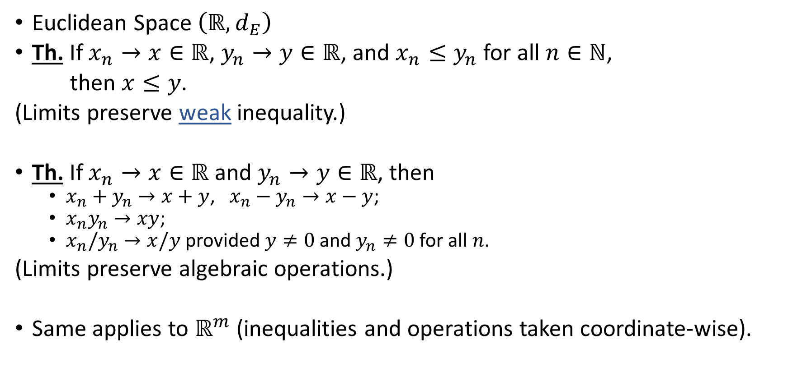

Sequences in $ℝ$ (and $ℝ^{m}$)
Euclidean Space $\left(ℝ,d_{E}\right)$
Th. If $x_{n}→x∈ℝ$, $y_{n}→y∈ℝ$, and $x_{n}≤y_{n}$ for all $n∈ℕ$,
then $x≤y$.
(Limits preserve weak inequality.)
Th. If $x_{n}→x∈ℝ$ and $y_{n}→y∈ℝ$, then
$x_{n}+y_{n}→x+y$, $x_{n}−y_{n}→x−y$;
$x_{n}y_{n}→xy$;
$x_{n}/y_{n}→x/y$ provided $y≠0$ and $y_{n}≠0$ for all $n$.
(Limits preserve algebraic operations.)
Same applies to $ℝ^{m}$ (inequalities and operations taken coordinate-wise).

Slide 9
Bolzano-Weierstrass Theorem
Bolzano-Weierstrass Theorem: Every bounded real sequence contains at least one convergent subsequence.
The proof is based on the following lemmas:
Lemma 1. (Monotone Convergence Th.) Every increasing sequence of real numbers that is bounded above converges. Every decreasing sequence of real numbers that is bounded below converges.
Lemma 2. Every real sequence contains either a decreasing subsequence or increasing subsequence (and possibly both).

Slide 10
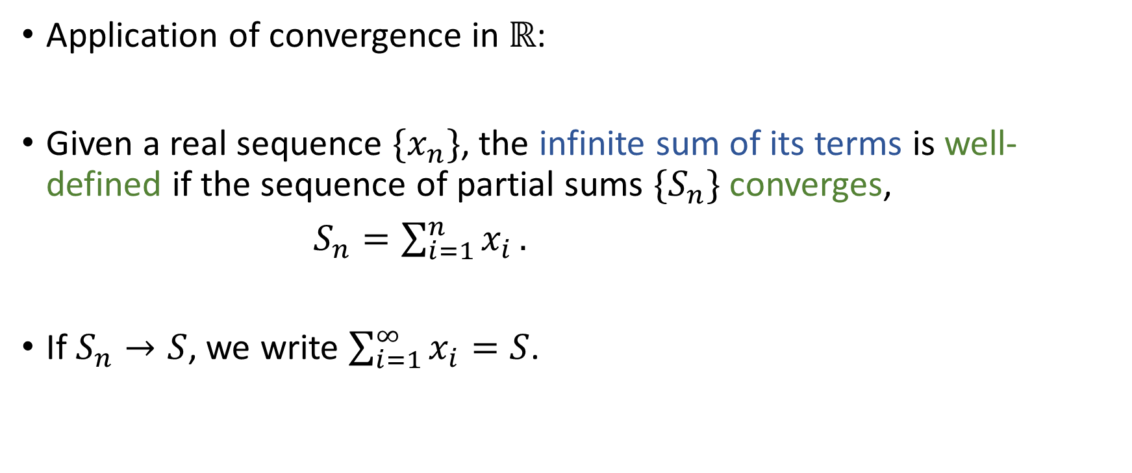
Infinite Sums
Application of convergence in $ℝ$:
Given a real sequence ${\{x}_{n}\}$, the infinite sum of its terms is well-defined if the sequence of partial sums ${\{S}_{n}\}$ converges,
$S_{n}=\sum_{i=1}^{n}{x_{i}}.$
If $S_{n}→S$, we write $\sum_{i=1}^{∞}{x_{i}=S}$.

